Slide 1

Convert Residential Houses into Sustainable Homes Using AI with Green Expectations LLC Team 8: William Fink, Frederick Mensah, Clayton Kool, Justine Azigi

Slide 2
Revolutionizing Home Sustainability with AI
140 million housing units in the U.S. (2019 Census Bureau)
Residential emissions account for 20% of U.S. greenhouse gases
Emissions will vary due to energy sources, insulation, appliances, and behavior
Improvement of emissions can reduce the carbon footprint of homes and help with sustainability
Knowledge and resources using AI can help guide homeowners to greater sustainability in their specific case
Notes:
Good afternoon. So our project is regarding using R to help homeowners with sustainability.
For background - According to the Census Bureau, there are 140 million housing units in the US(as of 2019), and emissions from those housing units account for 20% of US greenhouse gas emissions
Depending on the equipment and methods used for particular homes, there can be considerable variability in the emissions from each house
Using sustainability resources, homeowners can improve the efficiency and reduce emissions of their home and become more green
Greener homes can also add value when selling, and buyers may be looking for greener homes when on the home search
Using AI the sustainability journey can work for homeowner's specific cases and help get the ball rolling for improving a house's sustainability

Slide 3
About GreenifiAI.com
Website for Green Expectations LLC.
Brokerage with emphasis on software development with AI tools and methods
Connects buyers and sellers with sustainability resources
Provides carbon footprint calculator to aid homeowners with sustainability
Blog with sustainability information and featured properties
Helps those with an interest in sustainability get started, connect with others, calculate their footprint, and learn what may be effective for their circumstances
Notes:
Green expectations is a crokerage that uses software and AI tools to bridge the gap between homeowners and the sustainability of their home. Homeowners can go to the Greenify website to learn about green equipment and methods, and look at green houses. They can also calculate their own home's carbon footprint. There are blog and informational pages as well that homeowners can use to work on improving house sustainability. Buyers and sellers can list their homes and look at other homes to connect on greener homes in the area and compare their home to others sustainability

Slide 4
Data
Input from user regarding their goals for sustainability
Glossary of sustainability topics and text descriptions
Energy-efficient equipment details
Sustainability gadget benefits
Construction materials and properties input data
Sustainability methods and language for chatbot model
Equations for CO² calculation of electric, gas, other usage of energy
Home public listing data from API connections to housing sites
Notes:
The data we will be using is going to be the prompt input from the users as far as their individual goals for their home, as well as any information they provide regarding their current home's sustainability. In addition to the specific user's input, there is a glossary with a large amount of method and equipment for austainability for the AI to use in generating its responses to owners inquiries and developing an action plan. That will be cleaned and stored for the model to use. The user profiles will also be stored in case there are return users. For carbon footprint calculation there are specific euqations however that may be out of scope for this particular project to add a calculator and we may just focus on the input of a homeowner's interests and home details and generating a plan for them and their home

Slide 5
Goals
Calculate homeowners' carbon footprint
2. Generate sustainable equipment ideas for homeowners with prompting
3. Provide potential sustainability action plans for homeowners
Notes:
The goals of the project will be to use input from the homeowner as well as a source of methods and equipment for sustainability to generate actions for a homeowner to take as well as advice and details on the sustainability of their home. We hope to provide useful advice for each homeowner and help to get them started in improving the sustanability of their home and learning more about sustainability

Slide 6

HOME PAGE
AI Assistant for GreenifyAI
Ready to Greenify Your Home?
A
D
M
I
N
I
S
T
R
A
T
I
O
N
Buy & Sell
Top 10 Sustainable Homes
Recommendation Packages
Preference Search
Seller Form
Buyer Transactions
Seller Transactions
Validations by AI and Human
User Area and Action Plan
Action Plan & Implementation Review
Matching
Implementation
Buyer Match
Seller Match
Information Security & Privacy
Reducing the risks and mitigating threats
By Owner
By Contractor
www.GrinifyAI.com
Notes:
For the high-level architecture, the orange box has the general blueprint for the application. An AI model will be developed that will integrate with the Greenify website and return recommendations and plans based on the user's inputs and general sustainability knowledge. The resulting model will be validated with a set of responses by real agents and advisors, so the recommendations will be actually useful and correct for the homeowner. Implementation will be monitored and future improvements and suggestions will be given to proceed with increasing the accuracy and capabilities of the website for users.
We will probably start with storing the glossary data for the AI to use, and having storage for the user input as well. We will develop an AI model and Shiny app in R to gather user input, then connect with the model and sustainability data to generate valid instructions and comments for the user. We will connect the app to the website so it can be hosted via the company and integrate it with the existing structure of their system.

Slide 7
Potential AI Value Propositions of Interest
2 AI Residential Property Sustainability Calculator
3 AI Residential Real Estate Sustainability Course
5 AI Play Role: Real Estate Agent
6 AI Residential Real Estate Sustainability Conversion Estimator

Slide 8
Timeline
2-19-2024 Project kickoff
2-24-2024 Data investigation
2-27-2024 Design of high-level structure
3-14-2024 Coding of chatbot model
3-21-2024 Testing of model and validation with advisors
3-25-2024 Deployment planning
4-1-2024 Deployment and monitoring of chatbot
4-1-2024+ Revisions and bug fixes
Notes:
The general wtimeline will include investigating the glossary of technical data as well as designing the high level architecture of the system. After that the actual coding will take place which should take a significant portion of the time. The app and model will be tested and validated for its responses to a set of prompts and inputs and once the accuracy is confirmed the implementation will be planned and take place for the solution. After deployment if there are any bugs or improvements to be made those can be actioned and future plans can be determined t further improve the solution. There will be regular checkins to ensure that the timeline is adhered to and any issues are addressed as soon as possible

Slide 9
Questions?
Notes:
Are there any questions?

Slide 10
Thank you!
Notes:
Are there any questions?

Slide 11
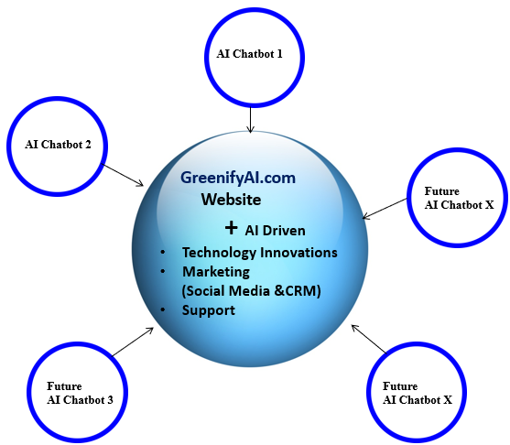
Add on to Architecture Phase 2
The available AI tool from OpenAI.io allows sending requests to the listing owner.
Our Conventional Buy has a current feed from New Jersey's largest MLS (GSMLS). The current AI tool allows users to scrape property information from each MLS or Sell by Owner Internet listings. The listing owner will be able to opt-in or opt-out.
Users can sell or action-converted houses on our website. Users can do it themselves or ask our agent to add their home to MLS.
For Phase 2, we can scrape available houses with sustainable house designations using AI prompts; we will create a list of prompts for users to choose from. First, we will establish all the needed criteria to scrape such properties from the Internet. We will start with New Jersey first.
Nation Wide Sustainable Properties
Create mini LLM models per State or Region
Create a Nationwide model of Sustainable Homes.
User Search & Fulfilment
www.GreenifyAI.com

